Slide 1


Collins Aerospace
1 Python Programmer
Providing The Best Engineering Services to
Redefining Aerospace, together..
SCA Automation Tool Interpret, Analyze and Visualize NVM data
Larsen & Toubro It’s all about Imagineering
Notes:
BITE Studio – this tool objective is to develop a Next Gen user friendly tool/application with modern user interfaces to easily analyse and decode the BITE fault records, hence improving the analysis capability and significantly reducing SME time.​ This tool helps to decode the raw NVM data and get user understandable info to interpret, analyse and visualize NVM raw data.

Slide 2
Overview
Goal:
Improve the efficiency and Productivity of SW development and verification activities.
Objective:
The Objective of this solution to improve efficiency of DO178 Software Structural Coverage process and availability of the coverage data and accuracy of the data. Objective is to improve 15-20% of SCA effort by implementing this framework to any existing or New programs. This will also enable the access to multi location team and reduce in software capital cost.
Notes:
Pradeep / Ajay – Update MFA

Slide 3
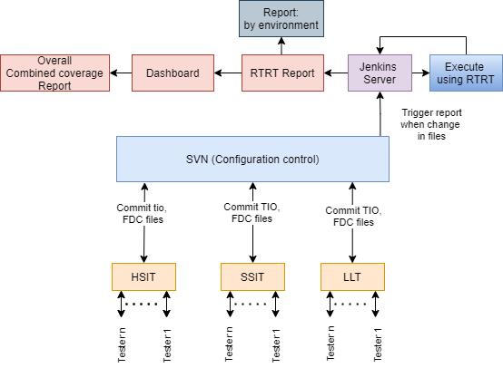
Framework (Architecture)
Mahesh to clean-up

Slide 4
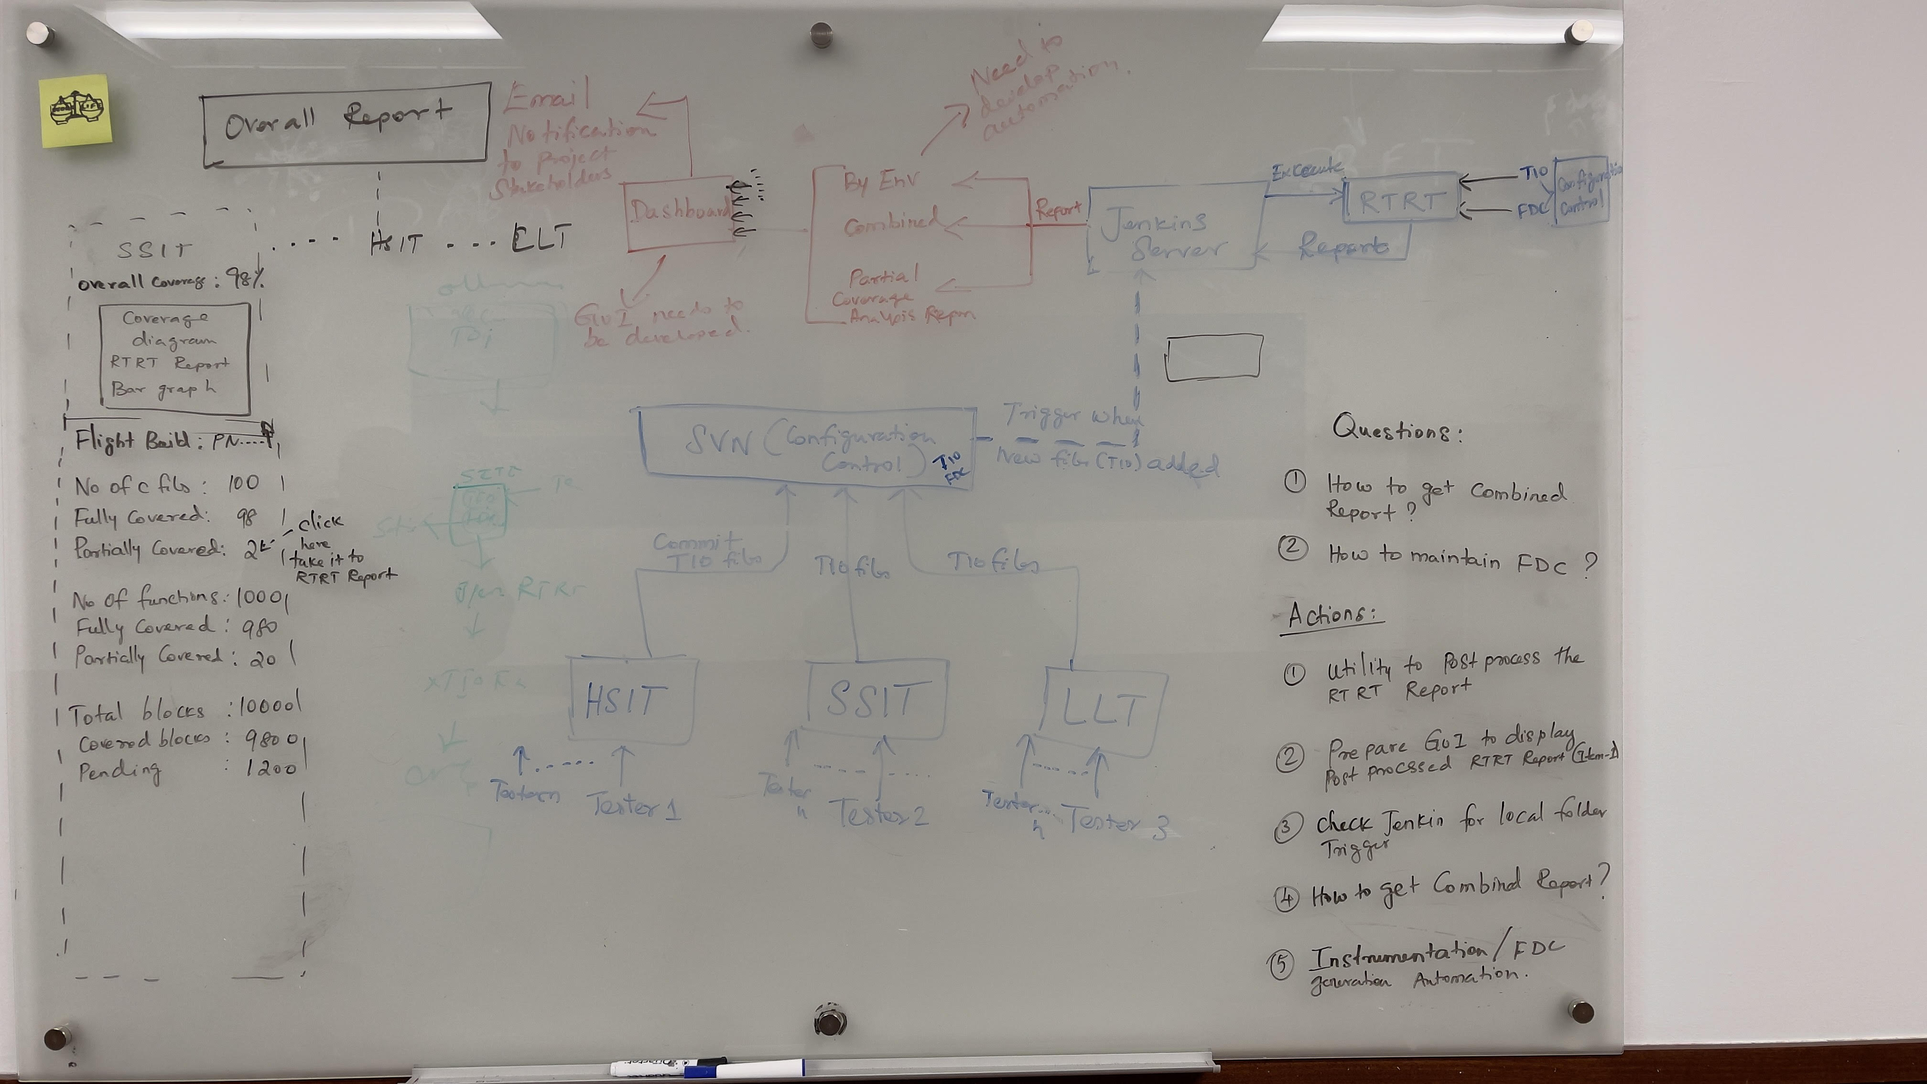
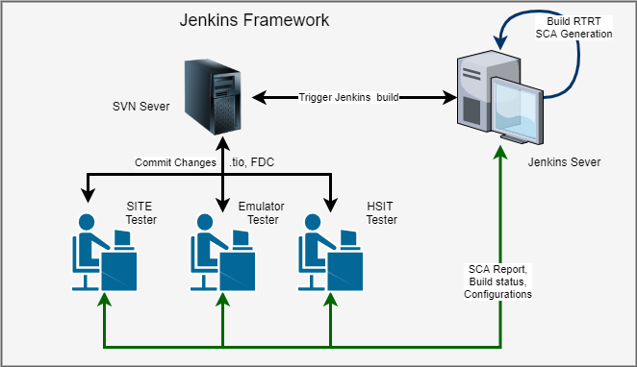
Framework (Architecture)
Mahesh to clean-up
Samba to create a SCA Automation framework
Samba/Nithin- Report
Backup slide refer slide#3 for update on framework diagram

Slide 5

Tool Features
Ganesh to clean-up
TIO & FDC files Check-in
FDC files setup at one time in SVN server
Allows continuous check-in of TIO files from different Test Env teams from anywhere in SVN server
RTRT setup with Jenkins
Tigger the Jenkins Job
Combined SCA Report inputs
Set up the batch file to generate combined report
RTRT setup with Jenkins
Tigger the Jenkins Job to generate combined Report
Coverage Analysis
Set up the Jenkin plugin to generate Coverage Analysis report for each test environment wise
Set up the batch file to generate over all Coverage Analysis
1
3
5
Dashboard
One RTRT license
2
4
6
Scalability
Machine Learning
SCA report Generation for each test environment wise
Option to generate the test environment wise report automatically when there is addition/change/modify the TIO in SVN server
Option to generate the Test environment wise report automatically by EOD.
Option to send RTRT report each environment wise to test team and required stakeholders through email whenever there is change in report
Combined SCA report Generation
Option to generate the combined report automatically when there is addition/change/modify the TIO in SVN server
Option to generate the combined report automatically by EOD.
Option to send combined RTRT report to test team and required stakeholders through email whenever there is change in report
Partial Coverage Analysis report Generation
Option to generate the partial coverage analysis report for each test environment wise
Option to generate the partial Overall coverage analysis report
Machine Learning
Excel based report

Slide 6
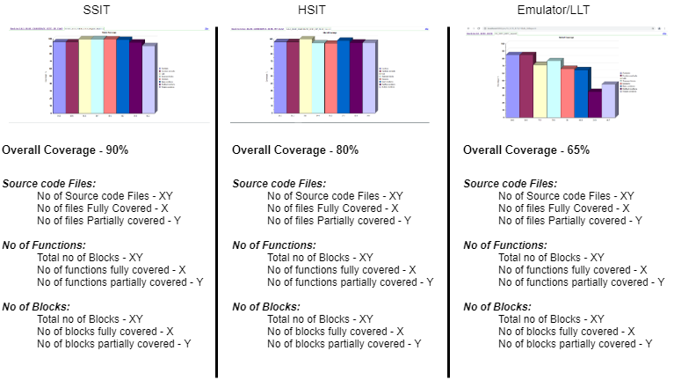
Dashboard

Slide 7
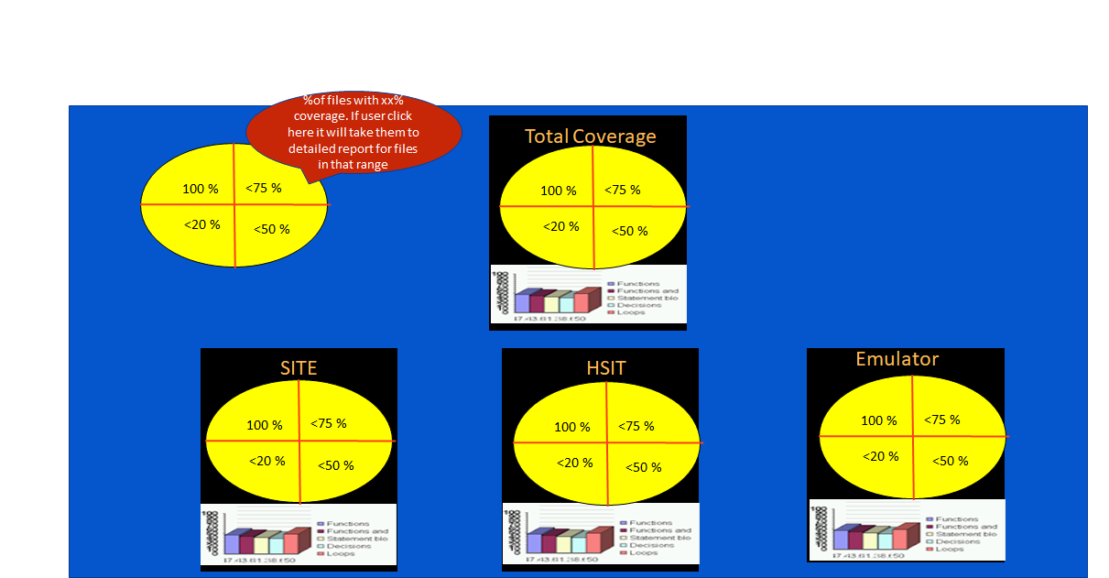
Dashboard
Nithin will create the dashboard and provide input to application for development.
Mahesh to clean-up
Backup slide refer slide#6 for update on Dashboard diagram

Slide 8
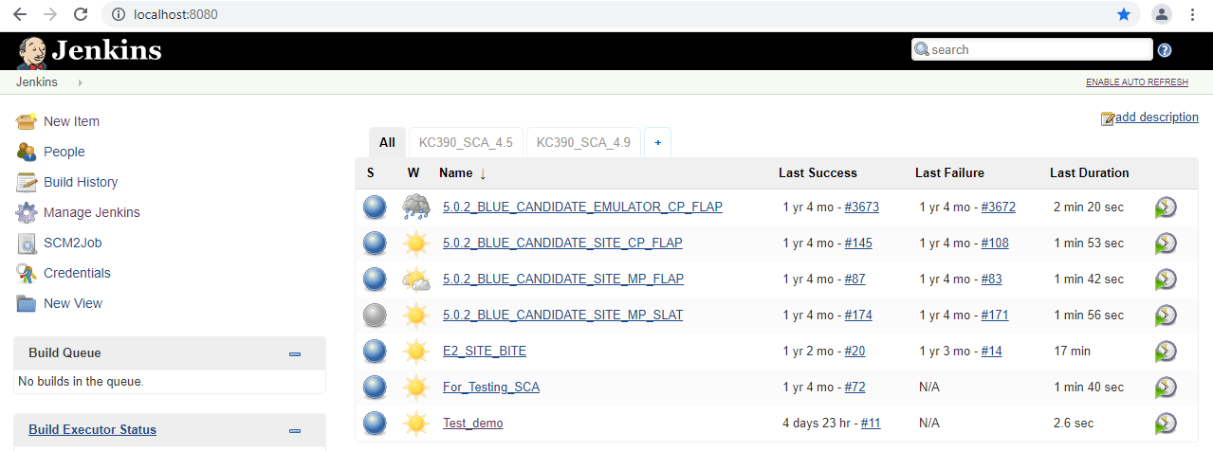
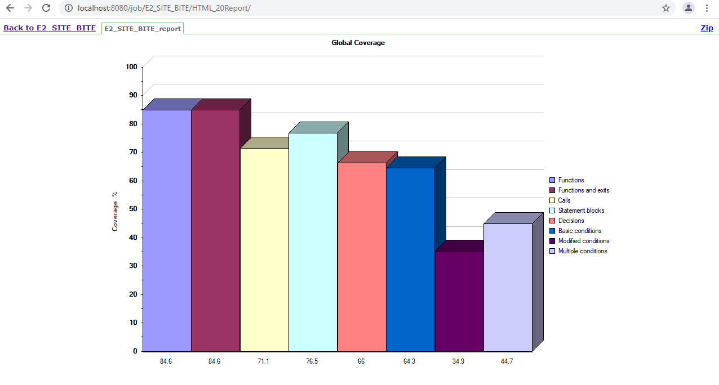
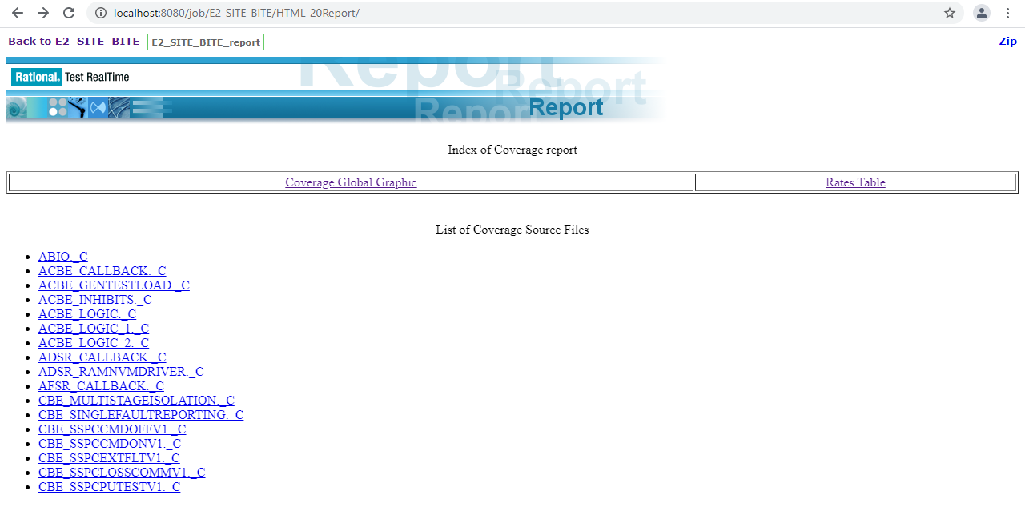
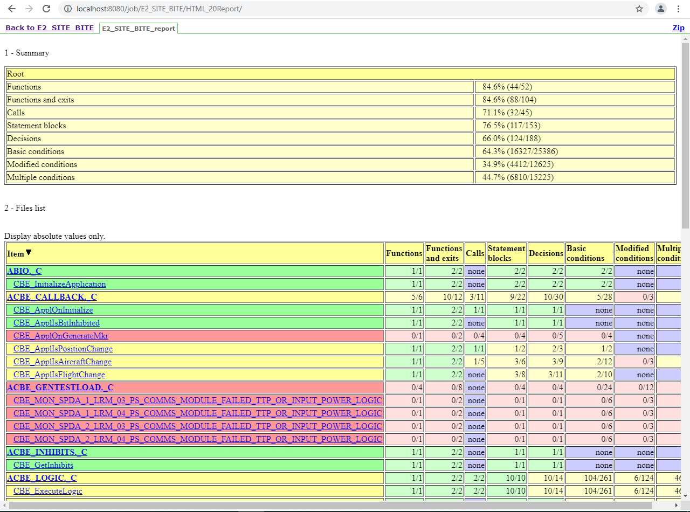
Snapshots
Actual Tool snapshots.. As needed..

Slide 9
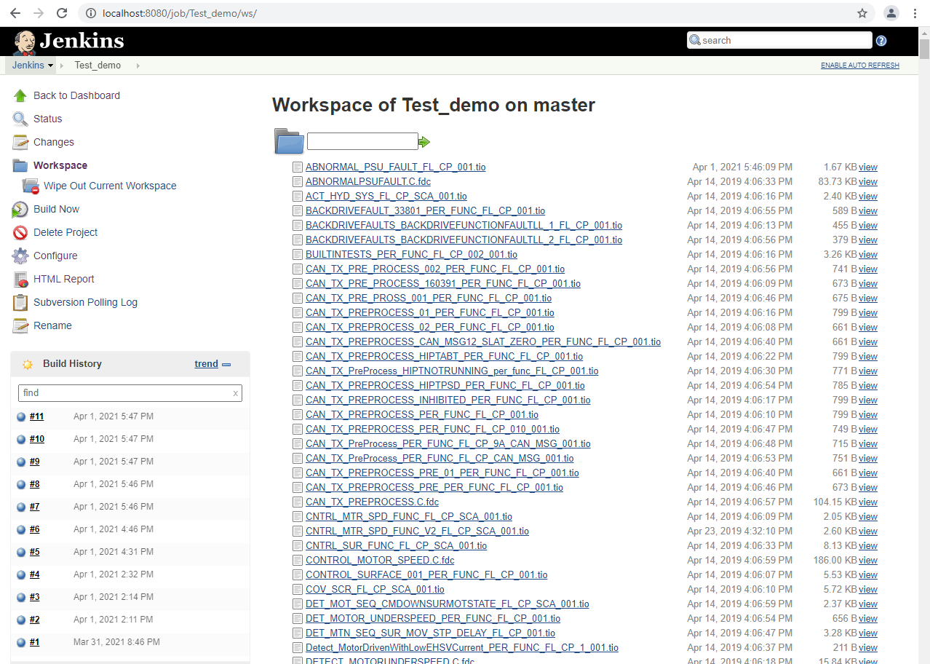
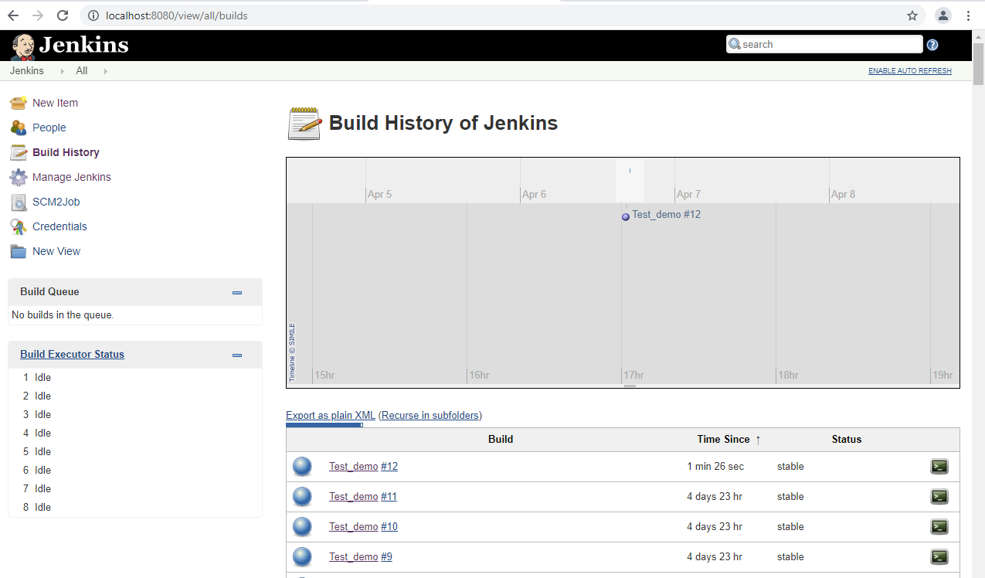
Snapshots
Actual Tool snapshots.. As needed..

Slide 10
Business Model
Ganesh/Samba/Nithin and Mahesh
To be done:
Slide update – Mahesh and Ganesh
Standalone trigger using Jenkins - Mahesh
Dashboard : Diagram development – ET and Mahesh
Combined report - Samba and Nithin
ECD: 23rd April 2021

Slide 11


Thank You

